Slide 1
Computing

Slide 2
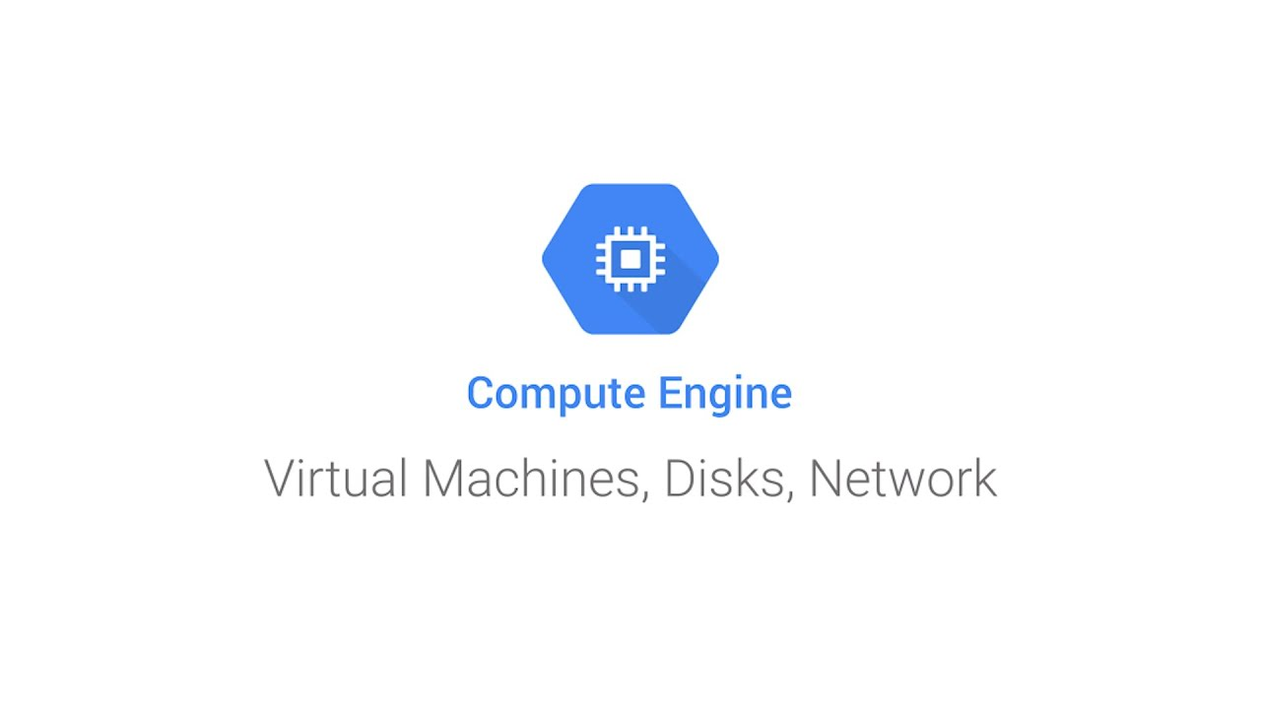
Google Compute Engine

Slide 3
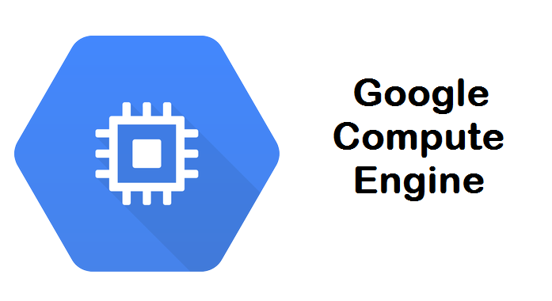
Google Compute Engine
is the Infrastructure as a Service component of the Google Cloud Platform, and it is based on the same worldwide infrastructure that powers Google's search engine, Gmail, YouTube, and other services. Users may utilize Google Compute Engine to create virtual computers on demand.
Notes:
https://en.wikipedia.org/wiki/Google_Cloud_Platform

Slide 4

You will be using Google's infrastructure Virtual machines networking storage And be placed in a safe place Google’s Data Center And Google will do those for you Scaling migrating maintenance Take over anything you don’t want to do.
Notes:
https://cloud.google.com/infrastructure

Slide 5

Infrastructure-as-a-service Google has resources 1. CPU 2. Memory 3. Networking 4. Persistency(Disks, Snapshot, Cloud Storage…) 5. Well-Trained engineering monkeys You have a business and be busy
Notes:
.microsoft.com/en-us/overview/what-is-iaas/

Slide 6
Google Compute Engine High-Performance Virtual Machines From micro-VM to a large instance Powered by Google’s Global network You could build a large cluster with strong and consistent bandwidth, provided by Google Load Balancing Spread incoming traffic across instances Fast Bullet Reloading Quick deployment of large VMs command-line interface web-based console Highly Secured All data written to disk in compute engine will be encrypted by the high-class encryption algorithm
Notes:
https://cloud.google.com/docs/security/infrastructure/design#:~:text=Google's%20infrastructure%20provides%20various%20storage,to%20protect%20data%20at%20rest.

Slide 7
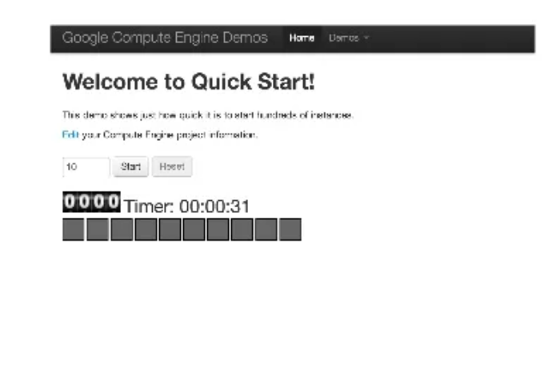
Instances on GCE
KVM-Based virtual machines
Fast booting time
Routinely takes less than 30 secs
Various OS support
Various machine types
https://slidetodoc.com/syn-406-architecting-citrix-for-google-compute-cloud/

Slide 8







Operating Systems
* Windows
Windows 2008 R2 SP 1
Windows 2012 R 2
* Linux
Open. Suse
SLES
RHEL
Cent. OS
Debian
Ubuntu

Slide 9
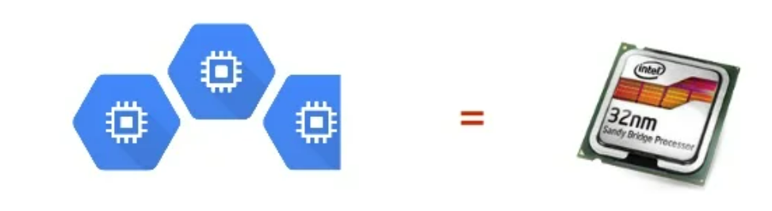
Google Compute Engine Units (GCEUs)
• A unit of CPU capacity used to describe the compute power of instance types
• 2. 75 GCEUs = 1 minimum power of 1 logical core on the Sandy Bridge platform

Slide 10
Machine Types (Shared-Core)
f 1 -micro
Shared Core
0. 6 GB Memory
g 1 –small
1 Core
1.7 GB Memory
1. 38 GCEUs

Slide 11
Machine Types (Standard)
n 1 -standard-n
Starts from 1 Core
Start from 3. 75 GB Memory
n | Virtual CPUs | Memory | GCEUs
1 | 1 | 3.75GB | 2.75
2 | 2 | 7.50GB | 5.50
4 | 4 | 15GB | 11
8 | 8 | 30GB | 30
16 | 16 | 60GB | 60
Notes:
https://cloud.google.com/compute/docs/machine-types

Slide 12
Machine Types (High Memory)
n 1 -highmem-n
Starts from 2 Core
Start from 13 GB Memory
n | virtual CPUs | Memory | GCEUs
2 | 2 | 13GB | 5.50
4 | 4 | 26GB | 11
8 | 8 | 52GB | 22
16 | 16 | 104GB | 44

Slide 13
Machine Types (High CPU)
n 1 -highcpu-n
Starts from 2 Core
Start from 13 GB Memory
n | Virtual CPUs | Memory | GECUs
2 | 2 | 1.8GB | 5.50
4 | 4 | 3.6GB | 1.1
8 | 8 | 7.2GB | 22
16 | 16 | 14.4GB | 44

Slide 14
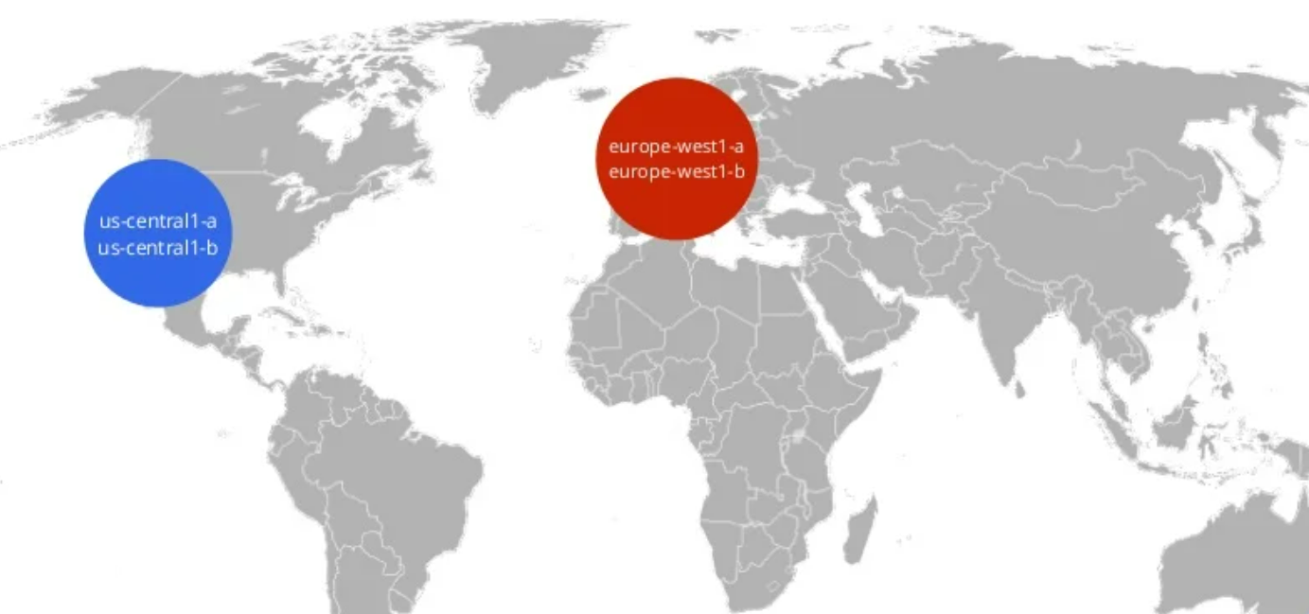
Regions and Zones
https://slidetodoc.com/syn-406-architecting-citrix-for-google-compute-cloud/

Slide 15
Live Migration • Transparent Maintenance • Auto-restart instances shutdown by system events • During transparent maintenance, you could set GCE to your instances in two ways: • Live Migrate Affect performance to some degree but your instances remain online (no downtime) • Terminate and reboot
Notes:
https://cloud.google.com/s/results/?q=live%20migration

Slide 16
Persistent Disk • Virtual SCSI device • Block Storage • Persistent until deleted • Hot-Plug to GCE instances (attach/detach)
Notes:
https://cloud.google.com/s/results/?q=persistent%20disk

Slide 17
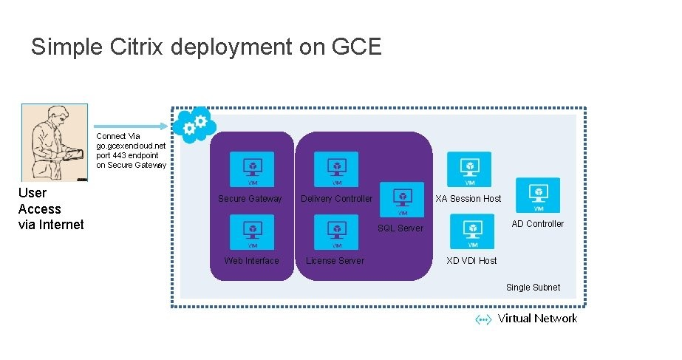
Simple Citrix deployment on GCE Connect Via go. gcexencloud. net port 443 endpoints on Secure Gateway User Access via Internet Secure Gateway Delivery Controller XA Session Host AD Controller SQL Server Web Interface License Server XD VDI Host Single Subnet Virtual Network
https://slidetodoc.com/presentation_image/bc3599d10108419441536c242ac2fba6/image-34.jpg

Slide 18
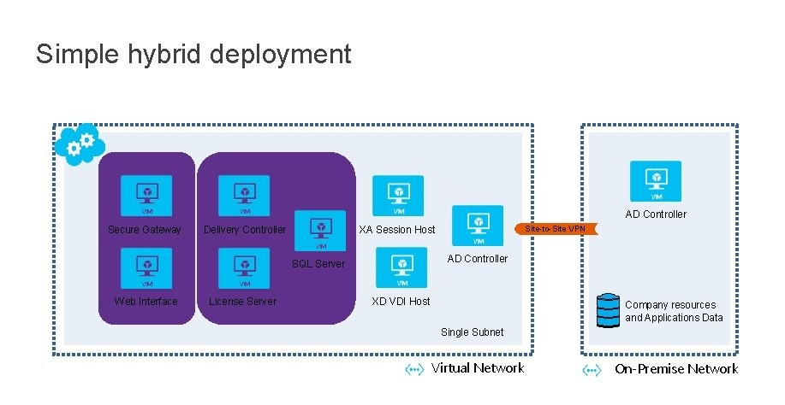
Simple hybrid deployment AD Controller Secure Gateway Delivery Controller AD Controller SQL Server Web Interface License Server Site-to-Site VPN XA Session Host XD VDI Host Company resources and Applications Data Single Subnet Virtual Network On-Premise Network
https://slidetodoc.com/presentation_image/bc3599d10108419441536c242ac2fba6/image-35.jpg

Slide 19
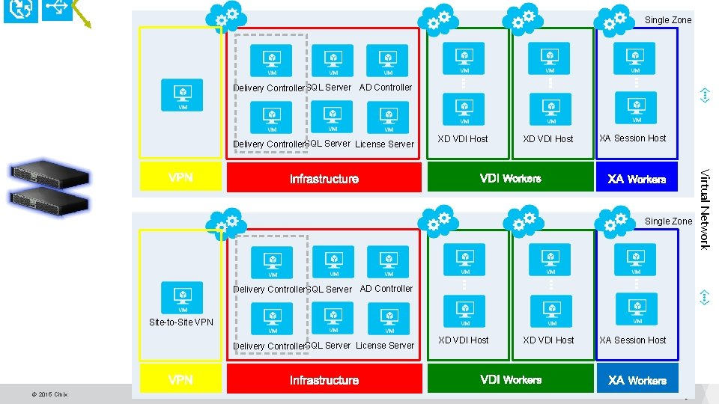
Single Zone Delivery Controller. SQL Server AD Controller Delivery Controller. SQL Server License Server XD VDI Host XA Session Host Delivery Controller. SQL Server AD Controller Site-to-Site VPN Delivery Controller. SQL Server License Server XD VDI Host XA Session Host Virtual Network Single Zone
https://slidetodoc.com/presentation_image/bc3599d10108419441536c242ac2fba6/image-36.jpg

Slide 20
Load Balancing • Target Pools • Health Checking • Forwarding Rules Persistent IP Addresses • GCE reserved IP for instance, won’t change with the reboot of VMs • You can promote ephemeral IP to persistent IP • No DNS changing anymore
Architecture
• Basic architecture (quick jumpstart topology)
• Simple GCE only
• Simple Hybrid
• Extended architecture
• Scale
• Availability © 2015 Citrix
Notes:
https://cloud.google.com/load-balancing?hl=en
https://cloud.google.com/architecture?hl=en

Slide 21
Recipe for success • Deploy your Google Cloud Engine (GCE) components • Install and configure the Citrix components • Prepare your golden image • Clone the golden image • Add newly created VMs to Machine Catalog • Setup your Delivery Group Integrated networking Networking is a first-class object on GCE This means you could apply/unhappy it anytime easily pre-defined networks before the first instance started
Notes:
https://cloud.google.com/docs/security/infrastructure/design#safe

Slide 22
Multi-Region Resources Those resources are global resources 1.Images(OS Images) 2. Snapshots 3. Network 4. Firewalls 5. Routes And they are also first-class objects in GCE
Notes:
https://cloud.google.com/resource-manager/docs/organization-policy/defining-locations-supported-services?hl=en

Slide 23
What are Google Cloud Functions? Google Cloud Functions is a serverless platform for developing and integrating cloud applications. Cloud Functions allows you to create simple, single-purpose functions that are linked to events generated by your cloud infrastructure and services. When an event that is being monitored is fired, your function is called. Your code runs in a completely controlled environment. There's no need to bother about setting up infrastructure or managing servers. On the Google Cloud Platform, Cloud Functions may be developed in JavaScript, Python 3, Go, or Java. You may execute your function in any Node.js (Node.js 10 or 12), Python 3 (Python 3.7 or 3.8), Go (Go 1.11 or 1.13), or Java (Java 11) environment, making portability and local testing a snap.
Notes:
https://cloud.google.com/s/results/?q=gooogle%20cloud%20functions&hl=en

Slide 24
Connect and extend cloud services
Cloud Functions provides a connective layer of logic that lets you write code to connect and extend cloud services. Listen and respond to a file upload to Cloud Storage, a log change, or an incoming message on a Pub/Sub topic. Cloud Functions augments existing cloud services and allows you to address an increasing number of use cases with arbitrary programming logic. Cloud Functions have access to the Google Service Account credential and are thus seamlessly authenticated with the majority of Google Cloud services, including Cloud Vision, as well as many others. In addition, Cloud Functions are supported by numerous Google Cloud client libraries, which further simplify these integrations.
Notes:
https://cloud.google.com/s/results/?q=connect%20and%20extend%20cloud&hl=en

Slide 25
Events and triggers
Cloud events are things that happen in your cloud environment. These might be things like changes to data in a database, files added to a storage system, or a new virtual machine instance is created.
Events occur whether or not you choose to respond to them. You create a response to an event with a trigger. A trigger is a declaration that you are interested in a certain event or set of events. Binding a function to a trigger allows you to capture and act on events. For more information on creating triggers and associating them with your functions, see Events and Triggers.
Serverless Cloud Functions removes the work of managing servers, configuring software, updating frameworks, and patching operating systems. The software and infrastructure are fully managed by Google so you just add code. Furthermore, the provisioning of resources happens automatically in response to events. This means that a function can scale from a few invocations a day to many millions of invocations without any work from you.
Notes:
https://cloud.google.com/docs/security/infrastructure/design#reducing

Slide 26
Use cases
Asynchronous workloads like lightweight ETL or cloud automation such as triggering application builds now no longer need their own server and a developer to wire it up. You simply deploy a function bound to the event you want and you're done.
The fine-grained, on-demand nature of Cloud Functions also makes it a perfect candidate for lightweight APIs and webhooks. In addition, the automatic provisioning of HTTP endpoints when you deploy an HTTP function means there is no complicated configuration required as there is with some other services. See the following table for additional common Cloud Functions use cases:
Notes:
https://cloud.google.com/architecture/multi-cloud-database-management?hl=en

Slide 27
Use case Data processing / ETL Description Listen and respond to Cloud Storage events such as when a file is created, changed, or removed. Process images, perform video transcoding, validate and transform data, and invoke any service on the internet from your Cloud Functions. Use case Webhooks Description Via a simple HTTP trigger, respond to events originating from 3rd party systems like GitHub, Slack, Stripe, or from anywhere that can send HTTP requests. Use case Lightweight APIs Description Compose applications from lightweight, loosely coupled bits of logic that are quick to build and that scale instantly. Your functions can be event-driven or invoked directly over HTTP/S.

Slide 28
Use case Lightweight APIs Description Compose applications from lightweight, loosely coupled bits of logic that are quick to build and that scale instantly. Your functions can be event-driven or invoked directly over HTTP/S. Use case Mobile backend Description Use Google’s mobile platform for app developers, Firebase, and write your mobile backend in Cloud Functions. Listen and respond to events from Firebase Analytics, Realtime Database, Authentication, and Storage. Use case IoT Description Imagine tens or hundreds of thousands of devices streaming data into Pub/Sub, thereby launching Cloud Functions to process, transform and store data. Cloud Functions lets you do it in a way that’s completely serverless.
Notes:
https://cloud.google.com/docs/security/infrastructure/design#secure_boot_stack_and_machine_identity

Slide 29
Cloud Functions Execution Environment Cloud Functions run in a fully-managed, serverless environment where Google handles infrastructure, operating systems, and runtime environments completely on your behalf. Each Cloud Function runs in its own isolated secure execution context, scales automatically, and has a lifecycle independent from other functions.
Notes:
https://cloud.google.com/s/results?hl=en&q=CLOUD%20FUNCTION%20EXECUTION%20ENVIRONMENTUSE%20CASES

Slide 30
Runtimes
Cloud Functions supports multiple language runtimes. You'll need the Runtime ID value if you're deploying functions from the command line or through Terraform.
Runtime | Base image | Runtime ID
Node.js 16 (recommended) | Ubuntu 18.04 | nodejs16
Node.js 14 | Ubuntu 18.04 | nodejs14
Node.js 12 | Ubuntu 18.04 | nodejs12
Node.js 10 | Ubuntu 18.04 | nodejs10
Node.js 8 (deprecated) | Ubuntu 18.04 | nodejs8
Node.js 6 (decommissioned) | Debian 8 | Nodejs6
Python 3.9 (recommended) | Ubuntu 18.04 | Python39
Python 3.8 | Ubuntu 18.04 | Python38
Python 3.7 | Ubuntu 18.04 | python37
Notes:
https://cloud.google.com/deployment-manager/runtime-configurator?hl=en

Slide 31
Runtime | Base image | Runtime ID
Go 1.16 (recommended) | Ubuntu 18.04 | go116
Go 1.13 | Ubuntu 18.04 | go113
Go 1.11 | Ubuntu 18.04 | go111
Java 17 (preview) | Ubuntu 18.04 | java17
Java 11 (recommended) | Ubuntu 18.04 | java11
.NET Core 3.1 (recommended) | Ubuntu 18.04 | dotnet3
Ruby 3.0 (preview) | Ubuntu 18.04 | ruby30
Ruby 2.7 (recommended) | Ubuntu 18.04 | ruby27
Ruby 2.6 | Ubuntu 18.04 | ruby26
PHP 7.4 (recommended) | Ubuntu 18.04 | php74
Updates to the runtimes are generally done automatically unless otherwise notified. All runtimes receive automatic updates to the language version as they are made available to the language community. Similarly, Cloud Functions might apply updates to other aspects of the execution environment, such as the operating system or included packages. These updates help keep your function secure.

Slide 32
Stateless functions
Cloud Functions implements the serverless paradigm, in which you just run your code without worrying about the underlying infrastructure, such as servers or virtual machines. To allow Google to automatically manage and scale the functions, they must be stateless—one function invocation should not rely on an in-memory state set by a previous invocation. However, the existing state can often be reused as a performance optimization; see the recommendation in Tips and Tricks for details.
For example, the counter value returned by the following function does not correspond to the total function invocation count because invocations might be handled by different function instances, which don’t share global variables, memory, file systems, or another state:
Notes:
https://cloud.google.com/deployment-manager/runtime-configurator?hl=entegrity_and_isolation

Slide 33
Node.js
// Global variable, but only shared within function instance. let count = 0; /** * HTTP Cloud Function that counts how many times * it is executed within a specific instance. * * @param {Object} req Cloud Function request context. * @param {Object} res Cloud Function response context. */ exports.executionCount = (req, res) => { count++; // Note: the total function invocation count across // all instances may not be equal to this value! res.send(`Instance execution count: ${count}`); };

Slide 34
Python
# Global variable, modified within the function by using the global keyword. count = 0 def statelessness(request): """ HTTP Cloud Function that counts how many times it is executed within a specific instance. Args: request (flask.Request): The request object. <http://flask.pocoo.org/docs/1.0/api/#flask.Request> Returns: The response text, or any set of values that can be turned into a Response object using `make_response` <http://flask.pocoo.org/docs/1.0/api/#flask.Flask.make_response>. """ global count count += 1 # Note: the total function invocation count across # all instances may not be equal to this value! return 'Instance execution count: {}'.format(count)

Slide 35
Go
// Package http provides a set of HTTP Cloud Functions samples. package http import ( "fmt" "net/http" ) // count is a global variable, but only shared within a function instance. var count = 0 // ExecutionCount is an HTTP Cloud Function that counts how many times it // is executed within a specific instance. func ExecutionCount(w http.ResponseWriter, r *http.Request) { count++ // Note: the total function invocation count across // all instances may not be equal to this value! fmt.Fprintf(w, "Instance execution count: %d", count) }

Slide 36
Java
import com.google.cloud.functions.HttpFunction; import com.google.cloud.functions.HttpRequest; import com.google.cloud.functions.HttpResponse; import java.io.BufferedWriter; import java.io.IOException; import java.util.concurrent.atomic.AtomicInteger; public class ExecutionCount implements HttpFunction { private final AtomicInteger count = new AtomicInteger(0); @Override public void service(HttpRequest request, HttpResponse response) throws IOException { count.getAndIncrement(); // Note: the total function invocation count across // all instances may not be equal to this value! BufferedWriter writer = response.getWriter(); writer.write("Instance execution count: " + count); } }
If you need to share state across function invocations, your function should use a service such as Datastore, Firestore or Cloud Storage to persist data. For a complete list of available storage options, see Choosing a storage option.

Slide 37
Auto-scaling and Concurrency
Cloud Functions handles incoming requests by assigning them to instances of your function. Depending on the volume of requests, as well as the number of existing function instances, Cloud Functions may assign a request to an existing instance or create a new one.
Each instance of a function handles only one concurrent request at a time. This means that while your code is processing one request, there is no possibility of a second request being routed to the same instance. Thus the original request can use the full amount of resources (CPU and memory) that you requested.
In cases where inbound request volume exceeds the number of existing instances, Cloud Functions may start multiple new instances to handle requests. This automatic scaling behavior allows Cloud Functions to handle many requests in parallel, each using a different instance of your function.
Because concurrent requests are processed by different function instances, they do not share variables or local memory. This is discussed in detail later in this document.
Notes:
https://cloud.google.com/s/results/?q=auto%20scaling%20and%20concurrency&hl=en

